Slide 1
Milo School Annual Report 2020-2021

Slide 2

About this template
Section 1: Vision, Mission, and Values
VISION
Empowering lifelong learners
MISSION
We will strive for excellence and be an engaging, collaborative, and global community; through high expectations, student leadership and family values.
VALUES
High expectations
Student independence and leadership
Family values

Slide 3
Section 2: Data/Evidence
Unfortunately we lack some formal data to assist in our planning and reporting. While our PAT numbers are often suppressed because of low numbers anyway, COVID prevented our students from writing. Additionally, we had planned to do the Our School Survey in the Spring but didn’t have the chance before schools were closed due to Covid.
We are going to administer the Math Intervention Programming Instrument to our students in January, then each fall moving forward. This will help identify areas of need in Math.

Slide 4
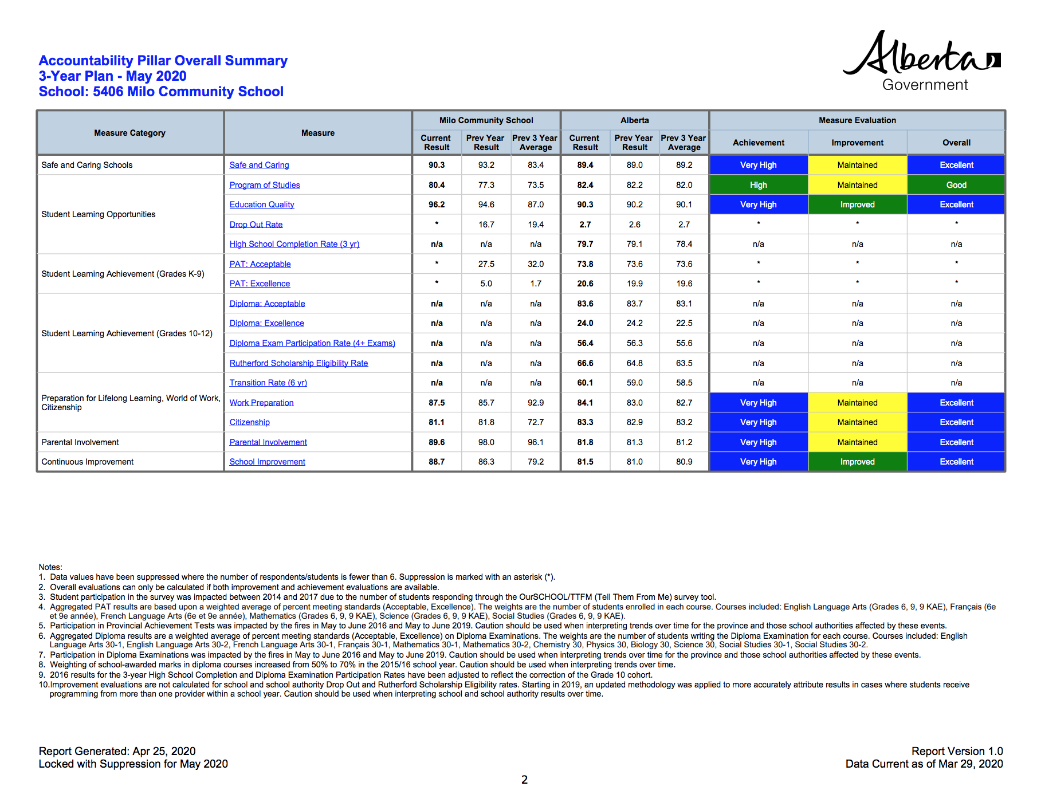

Slide 5
Accountability Report Summary

Slide 6

Safe and Caring Schools
Overall the respondents agree, or strongly agree, that our school is a very safe and caring place with a couple of parents identifying that they don’t always think students treat one another well,

Slide 7

Student Learning Opportunities
Everyone agreed, or strongly agreed that students at Milo receive a broad program of studies. Some parents were dissatisfied with their children’s opportunity to learn another language; we do offer self directed language learning in options through Duolingo, so we need to ensure that our families are more aware of this.

Slide 8

Preparation for Lifelong Learning, World of Work, Citizenship
Most of our parents agree or strongly agree that we prepare their children for lifelong learning, the world of work, and citizenship.
One parent responded that they don’t agree that students treat one another with respect, and that they don’t always help each other when they can.

Slide 9

Parental Involvement
Most of our parents report that they are satisfied or very satisfied in their involvement, or opportunity to be involved in the school.
Sadly, with COVID protocols we will not be able to have our families into the building as we are used to so we need to try to find creative ways to get our parents involved beyond parent council.

Slide 10
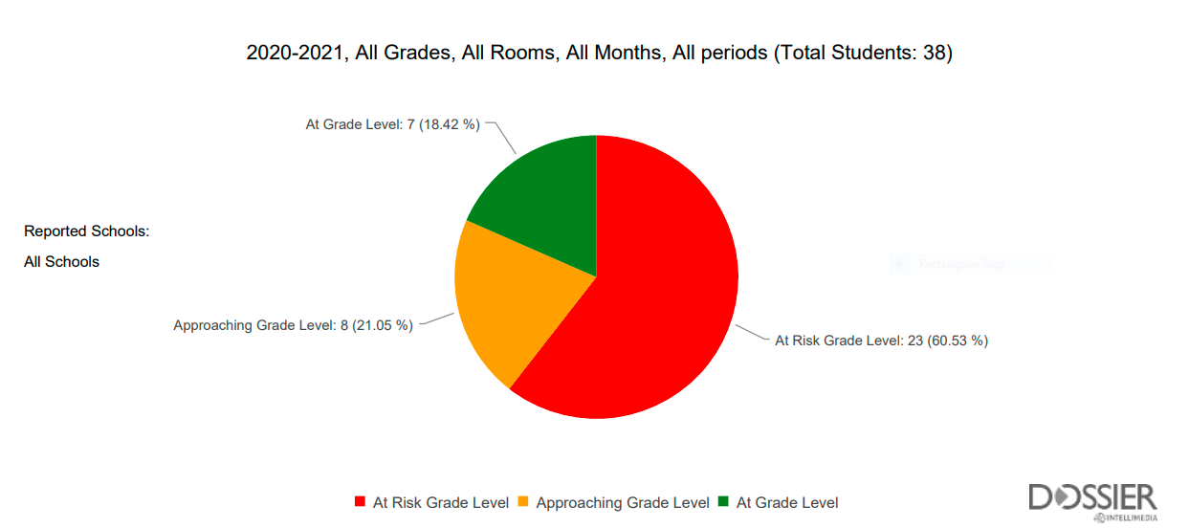
Fountas and Pinnell

Slide 11
Fountas and Pinnell
Though we still have many students who are at risk, we are doing a great job of supporting these students in our school.
Unfortunately, many of our struggling readers did not read regularly once in school learning switched to online in the Spring, so the “Summer Slide” was more noticeable this year.
Although we do not have our volunteer readers coming into the school, we are doing reading pullouts, as well as Lively Letters interventions and have seen an incredible improvement in some of our non-readers.

Slide 12

Section 3: Strategic Planning

Slide 13
Goal 1
To improve cross curricular literacy skills, focusing on reading, writing, and vocabulary.

Slide 14
In two or three columns
Critical Evidence and Strategies for Goal 1: Cross Curricular Literacy
Strategies
Using Words Their Way program in classes, this is “a hands-on, developmentally-driven approach to word study that illustrates how to integrate and teach children phonics, vocabulary, and spelling skills”
We are teaching Computer Literacy.
We are teaching about independent text use, features of text, and decoding text.
Leveled Literacy Intervention classes to support struggling readers.
Teach reading and writing strategies in all classes.
Vocabulary focus in all curricular areas (e.g. word walls and flash cards).
How will we know:
Review and monitor Fountas and Pinnell data to monitor student growth and target classroom instruction and interventions.
Classroom assessments.
Increase in student confidence and independence (e.g. we are seeing students try to help themselves and think more critically).
Anecdotal teacher, student, and parent feedback.

Slide 15
Goal 2
To improve numeracy skills for daily living.

Slide 16
You can also split your content
Critical Evidence and Strategies for Goal 2: Numeracy Skills for Daily Living
Strategies
Extra Educational Assistant time will be available in Math classes.
Mathletics for practice.
Mental math for basic facts
Utilise Math Intervention Programming Instrument (MIPI) to determine programming and student need - planned to administer first week of November but we have been missing so many students since our COVID exposure
How will we know:
Use of Key Math Assessments (Level B test like the WIAT to help determine specific learning needs in Math)
Classroom assessments.
Anecdotal student and parent feedback.
MIPI data

Slide 17
Canadian Daily Math | Daily | Daily concepts cover number sense, patterning with algebra, measurement, data management, and geometry.
Problem Solving using real life examples | Daily-Weekly | Eg. writing cheques of kindness, calculating tip/tax at a restaurant.
Think Aloud | Daily | Similar to ‘read aloud’ in LA. As I work through math problems on the whiteboard, I explain the thinking process, especially for mental math things.
Estimation | Daily-Weekly | Making guesses and checking for accuracy. Also using simple rounding to guess answers before trying to solve as a good way to test if your answer makes sense.
Logic Puzzles | Monthly, or when done in class work | Currently using Hidato, Sudoku, Kakuro puzzles for spatial awareness and simple number pattern practice.
Colour by Number - Basic Facts (+,-,x,/) | Monthly, or when done in class work | Quick mixed facts with increasing difficulty to create a colour. Also helps students recognize patterns using the colours.
Flash Cards - Basic Facts (+,-,x,/) | Pull outs with Mrs. Hall | Practicing basic facts to become more confident and proficient. Also have an online version.
Math Games | Weekly-Monthly | Online questions as well as arcade games related to the current math skills being practiced.

Slide 18
Goal 3
Build a safe, caring, connected learning community of students, staff and parents

Slide 19
You can also split your content
Critical Evidence and Strategies for Goal 3: Safe and Caring
Strategies
Since we are all motivated in different ways staff are undergoing Professional Development targeted toward motivating students to help more students feel successful at school (e.g. Rick Lavoi).
Staff will recertify SIVA (Supporting Individuals through Valued Attachments) training to gain “proactive tools and practical knowledge to create an environment where safety is a pro-social, healthy, and respectful part of day-to-day life.” www.sivatraining.ca
Staff are clear on all current Covid protocols, and will ensure that all staff members are working to keep our school community safe.
Using the Universal Strategies list provided by our service providers to provide timely and useful interventions as needed for our students.
We are continuing to work with students to build resilience and prepare them for uncertainty.
Continue to work to be a trauma informed school.
The Fourth R teacher training, and in health lessons consisting “of a comprehensive, school-based program designed to include students, teachers, parents, and the community in reducing violence and risk behaviours.”
How will we know:
Accountability Pillar results
Our School Survey results
Anecdotal teacher, student, and parent feedback
Our guest teachers comment on what a wonderful, welcoming, family oriented school we are.

Slide 20
Section 4: Trends and Issues
We have a high population (for Milo) of young children who will be entering our school population in the next few years with 3 in kindergarten and 6 in Pre-K.
-One trend from our Accountability Pillar results is that we need to ensure that our students and community stakeholders feel that our students treat each other well.
-We gained 3 new students this year, 2 from Calgary and 1 from Lethbridge because of our small class sizes
-Like all schools, we are working within the reality of living in a pandemic, student attendance was great until Siksika Board of Education grounded their buses. .

Slide 21
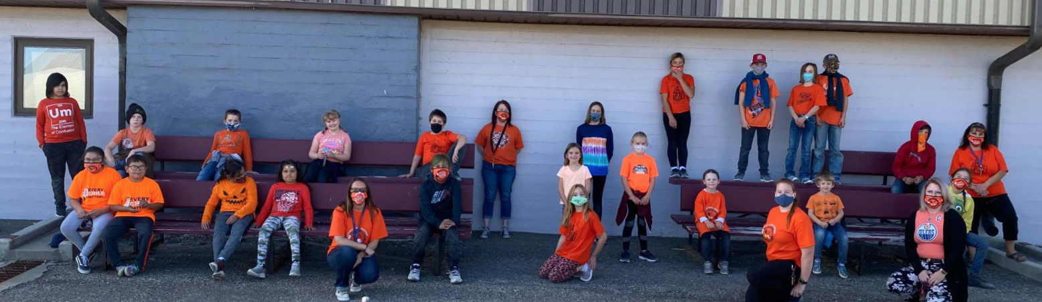
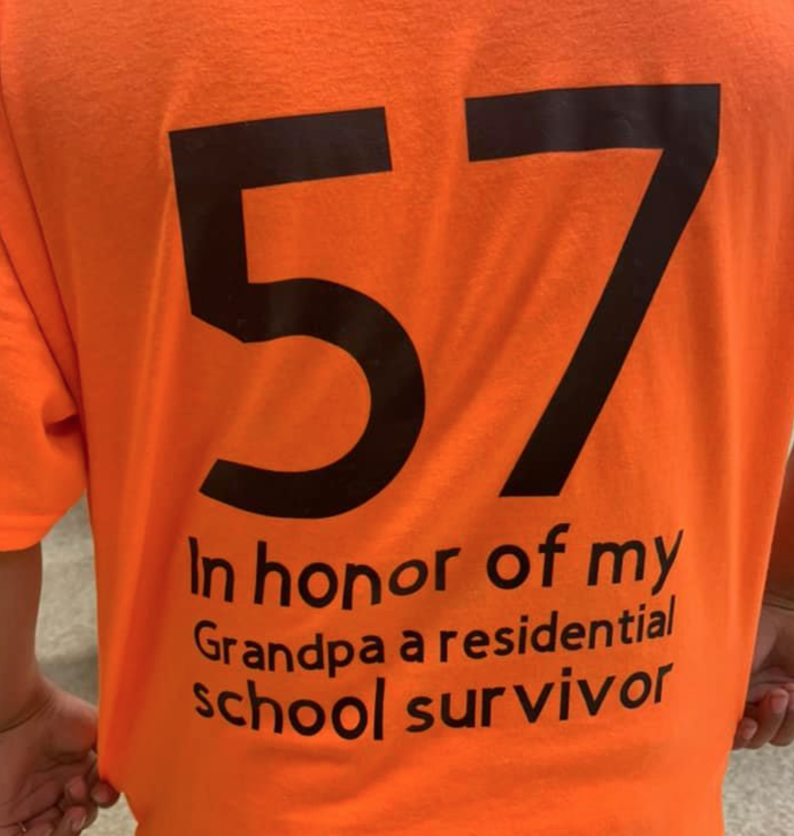

Section 5: Celebrations

Slide 22
Celebrations: Connecting with Families (and appreciating our bus drivers a little more…)

Slide 23
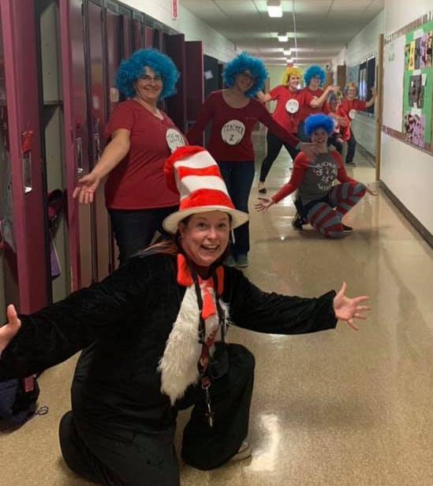
Thank you!

